Slide 1
What does it mean when we say that an algorithm X is asymptotically more efficient than Y?
Options:
X will always be a better choice for small inputs
X will always be a better choice for large inputs
Y will always be a better choice for small inputs
X will always be a better choice for all inputs
X will always be a better choice for large inputs

Slide 2
1. What is the time, space complexity of following code:
int a = 0, b = 0;
for (i = 0; i < N; i++) {
a = a + 10;
}
for (j = 0; j < M; j++) {
b = b + 20;
}
1. O(N + M) time, O(1) space

Slide 3
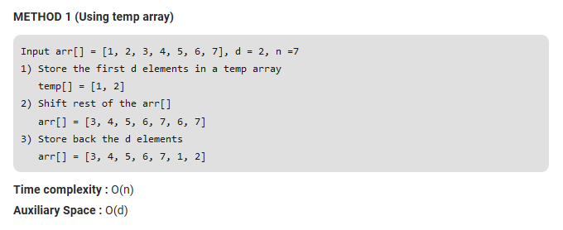
Understanding auxiliary space requirement
Array rotation

Slide 4

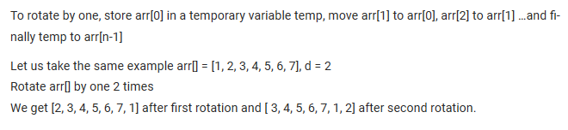

Understanding auxiliary space requirement
Array rotation

Slide 5
2. What is the time complexity of following code:
int a = 0;
for (i = 0; i < N; i++) {
for (j = N; j > i; j--) {
a = a + i + j;
}
}
O(N*N)

Slide 6
3. What is the time complexity of following code:
int i, j, k = 0;
for (i = n / 2; i <= n; i++) {
for (j = 2; j <= n; j = j * 2) {
k = k + n / 2;
}
}
O(nLogn)

Slide 7
4. What is the time complexity of following code:
int a = 0, i = N;
while (i > 0) {
a += i;
i /= 2;
}
O(log N)

Slide 8
5. What is the time complexity of following code:
void fun(int n, int k)
{
for (int i=1; i<=n; i++)
{
int p = pow(i, k);
for (int j=1; j<=p; j++)
{
// Some O(1) work
}
}
}
O(n^(k+1))

Slide 9
6. What is the time complexity of following code:
int result=0;
for (int i=0; i<N; i++)
for (int j=i; j<N; j++) {
for (int k=0; k<M; k++) {
int x=0;
while (x<N) { result++; x+=3; }
}
for (int k=0; k<2*M; k++)
if (k%7 == 4) result++;
}
O(MN^3)

Slide 10
7. What is the time complexity of following code:
for i = 1 to n:
for j = n to i:
ans += (i * j)
O(N^2)

Slide 11
8. What is the time complexity of following code:
while (n > 0):
ans += n % 10
n /= 10;
O(Log 10 N)

Slide 12
9. What is the time complexity of following code:
for (i = n; i >= 1; i /= 2):
for (j = 1; j <= m; j *= 2)
ans += (i * j)
O(Log M Log N)

Slide 13
10. What is the time complexity of following code:
for i = 1 to n:
for j = 1 to log(i):
ans += 1
O(N*logN)

Slide 14
11. What is the time complexity of following code:
def f(a):
n = len(a)
j = 0
for i = 0 to n - 1:
while (j < n and a[i] < a[j]):
j += 1
O(N)

Slide 15
12. What is the time complexity of following code:
i=1;
While ( i < = n ){
i=i+10;
i=i+5;
i =i+7;
}
O(N)

Slide 16
13. What is the time complexity of following code:
i=n;
While ( i > 1 ){
i=i/5;
i=i/2;
i =i/3;
i = 5*i
}
O(log 6 N)

Slide 17
14. What is the time complexity of following code:
i=2;
While ( i <n ){
i = i^2;
}
O(log 2 log 2 N )

Slide 18
15. What is the time complexity of following code:
i=12;
While ( i <n ){
i = i^29;
}
O(log 29 log 12 N )

Slide 19
16. What is the time complexity of following code:
i=n;
While ( i > 23 ){
i = i^(1/2);
i = i^(1/3);
i = i^(1/5);
i = i^5;
}
O(log 6 log 23 N)

Slide 20
17. What is the time complexity of following code:
for(i=1;i<=n*n;i=i+5)
for (j = n; j>7; j=j^{1/9} )
X = Y + Z;
(n^2)/5 * log 9 log 7 n or O(n^2 log log n)

Slide 21
18. What is the time complexity of following code:
for(i=1;i<=n;i=i++)
for (i = 1; i<=n²;i++)
for (i = 1; i<=n³;i++)
X = Y + Z;
O(n3)

Slide 22
19. What is the time complexity of following code:
for(i=1;i²<=n;i=i++)
for (j = 1; j²⁵<=n⁵;j++)
for (k = 1; k⁷⁵<=n¹⁰;k++)
X = Y + Z;
O(n^(5/6))

Slide 23
20. What is the time complexity of following code:
int fun1 (int n){ int i, j, k, p, q = 0; for (i = 1; i < n; ++i) { p = 0; for(j = n; j > 1; j = j/2) ++p; for(k =1; k < p; k = k*2) ++q; } return q; }
n log(log n)

Slide 24
Complexity Analysis of Recursive Program
Time complexity of a recursive function can be written as a mathematical recurrence relation
A recurrence relation is an equation that recursively defines a sequence where the next term is a function of the previous terms
Expressing F_{n} as some combination of F_{i} with i<n
e.g. Factorial calculation, Fibonacci series generation

Slide 25
Ways for solving recurrences
Substitution Method: We make a guess for the solution and then we use mathematical induction to prove the guess is correct or incorrect.
Recurrence Tree Method: In this method, we draw a recurrence tree and calculate the time taken by every level of tree. Finally, we sum the work done at all levels.

Slide 26
Complexity Analysis of Factorial Function
Definition: Fact(n): if (n==0) then
return 1
else
return n * Fact(n-1)
Assume 1 operation takes 1 unit of time
Comparision (n==0) -> 1 Unit
n-1 -> 1 Unit 3 Units of time
* -> 1 Unit
As per definition,
T(n) = T(n-1) + 3
T(0) = 1

Slide 27
Complexity Analysis of Factorial Function
T(n) = T(n-1) + 3
= T(n-2) + 6
= T(n-3) + 9
…….
= T(n-k) + 3 *k ------ eq. 1
We want to go till (n-k) = 0 or k = n
Substituting k eq. 1, T(n) = T(0) + 3 * n
Since T(0) = 1, T(n) = 1 + 3 * n which is O(n)

Slide 28
Complexity Analysis of Fibonacci Term
Definition: Fib(n): if (n<=1) then
return n
else
return Fib(n-1) + Fib(n-2)
Assume 1 operation takes 1 unit of time
Comparision (n<=0) -> 1 Unit
n-1 -> 1 Unit 4 Units of time
n-2 -> 1 Unit
+ -> 1Unit
As per definition,
T(n) = T(n-1) + T(n-2) + 4
T(0) = T(1) = 1

Slide 29
Complexity Analysis of Fibonacci Term
T(n) = T(n-1) + T(n-2) + 4
Since, T(n-1) ≈ T(n-2)
T(n) =2*(T(n-2)) + C , Similarly
= 2*(2*T(n-4) +C) +C
= 4*(T(n-4) + 3*C)
= 8*(T(n-6) + 7*C)
= 16*(T(n-8) + 15*C)
= …….
=2^{k}*(T(n-2*k) + (2^{k} – 1)*C ) ------ eq. 1
We want to go till (n-2*k) = 0 or k = n/2
Substituting k eq. 1, T(n) = 2^{n/2} *(T(0) + (2^{n/2} -1)*C)
Since T(0) = 1, T(n) = 2^{n/2} *(1+ (2^{n/2} -1)*C) which is O(2^{n})

Slide 30
21. What is the time complexity of following code:
def gcd(a, b):
if (a < b) swap(a, b)
if (b == 0) return a;
else return gcd(b, a % b)
O(log N) where n is maximum between a and b

